Slide 1
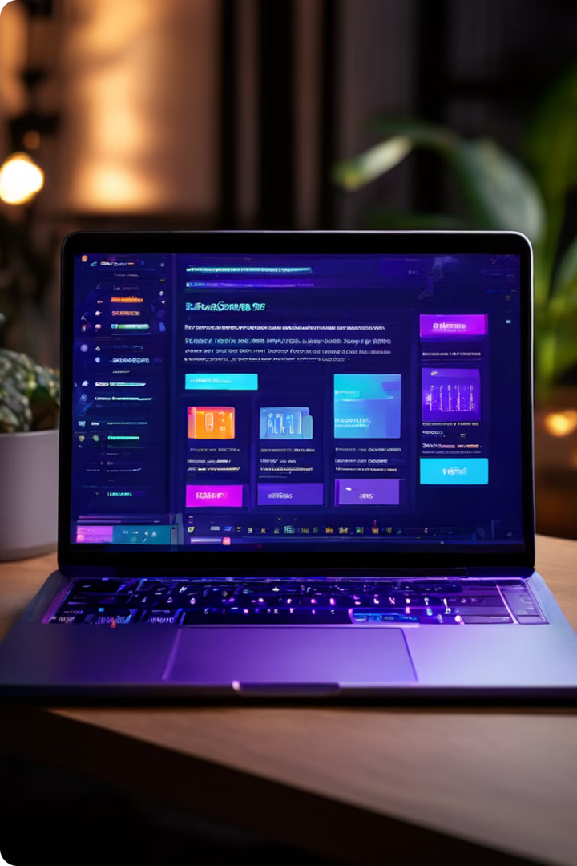
Billing Software in Python
by
Dilshad Ahmad (10800220064)
Adrita Pathak (10800220080)
Meghal Pandey (10800220009)
Anmol Kumar Gupta (10800220041)

Slide 2

Introduction to Billing Software
The Billing software using python is a simple yet effective Python application designed to facilitate the billing process for grocery stores. Developed using the Tkinter library, a standard GUI toolkit for Python, this project offers an intuitive graphical interface for both customers and store owners to manage transactions seamlessly.
In this project, users can input customer details such as name and phone number, along with the quantity of various grocery items purchased. The application then calculates the total bill amount, including taxes, providing a comprehensive overview of the transaction.
These programs often come with a variety of features, such as customizable invoice templates, automated payment reminders, and detailed reporting capabilities. By leveraging the power of billing software, businesses can gain valuable insights into their revenue streams and make informed decisions about their finances.

Slide 3

Why Python for Billing Software
Python is a versatile and powerful programming language, widely used in various fields. It has a comprehensive ecosystem of libraries specifically designed for building robust billing applications.
Python's simplicity and readability make it an ideal choice for developing billing systems. The language's intuitive syntax and clear structure allow for easy code maintenance and collaboration.
Python boasts a vast collection of open-source libraries that handle complex billing functionalities, such as generating invoices, processing payments, and managing customer accounts.
Python's integration with other technologies, including databases and payment gateways, simplifies the development process. This seamless integration streamlines billing workflows and improves efficiency.

Slide 4
Key Features:
User-Friendly Interface: The graphical user interface (GUI) makes it easy for users to navigate and input data effortlessly.
Customer Details: Customers can enter their name and phone number for record-keeping purposes.
Itemized Billing: The system allows users to specify the quantity of each grocery item purchased, enabling accurate billing.
Automatic Calculation: Total prices for food, grocery, and other items, along with their respective taxes, are calculated automatically, streamlining the billing process.
Detailed Bill Generation: The application generates a detailed bill listing all purchased items, quantities, prices, and the total amount payable.
Clearing and Exiting: Users have the option to clear the bill area to start afresh or exit the application once the transaction is complete.

Slide 5
Code Explanation:
This code creates a simple Grocery Billing System using Tkinter, a Python GUI library. Let’s break down the code:
Import Statements: The code starts by importing necessary modules – tkinter for GUI and random for generating random bill numbers.
Class Definition: The Bill_App class is defined, which serves as the main application class.
Initialization: In the __init__ method of the class, the GUI window is configured with a specific size, title, and components.
Variable Initialization: Several StringVar and IntVar variables are initialized to hold customer details and the quantity of various items purchased.
GUI Layout:
The layout is organized using Label, Entry, and LabelFrame widgets to represent different sections such as customer details, food items, grocery items, others, bill area, and buttons.
Each section contains labels and entry fields to input data.

Slide 6
Functions:
total: Calculates the total prices for food, grocery, and other items, along with their respective taxes.
welcome_soft: Updates the text area with custom details and a header for the bill list.
clear: Clears the bill area.
bill_area: Adds product names, quantities, and prices to the bill area.
exit: Closes the application window.
Clear function()
Generate Bill ()

Slide 7
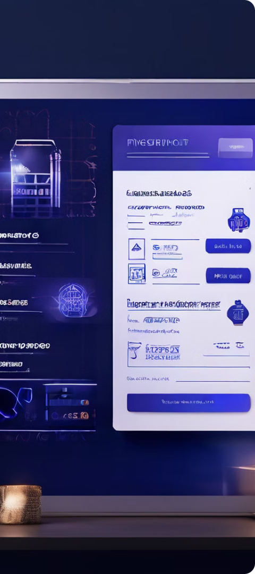
Core Features of Billing Software
Invoice Generation
Billing software must be able to create professional invoices. These invoices should include a customer's name, address, and billing information. Invoices should also itemize the products or services purchased, along with their prices and quantities. The software should allow users to customize the invoice template to match their branding.
Reporting and Analytics
Billing software should provide detailed reports and analytics on sales, revenue, and expenses. These reports can help businesses understand their financial performance and make informed decisions. The software should offer customizable reporting options, allowing users to analyze data based on specific criteria.

Slide 8



Reporting and Analytics
Billing software offers robust reporting and analytics capabilities, providing valuable insights into your business performance. By analyzing data on invoices, payments, and customer behavior, you can gain a comprehensive understanding of your financial health, identify trends, and make informed decisions.
Detailed Reports
Generate reports on sales, revenue, expenses, and customer activity, providing granular insights into your business performance.
1
Trend Analysis
2
Identify patterns and trends in your billing data, helping you forecast future revenue, predict customer needs, and optimize pricing strategies.
Customer Insights
3
Gain insights into customer behavior, understand their payment patterns, and identify opportunities for targeted marketing and customer retention efforts.
These insights allow you to optimize your billing processes, improve customer satisfaction, and drive overall business growth. You can also integrate reporting and analytics with your existing business intelligence tools, creating a unified view of your data and enabling more strategic decision-making.

Slide 9
Python Libraries for Billing Software
1
Tkinter
The Billing software using python is a simple yet effective Python application designed to facilitate the billing process for grocery stores. Developed using the Tkinter library, a standard GUI toolkit for Python, this project offers an intuitive graphical interface for both customers and store owners to manage transactions seamlessly.
Tkinter is a graphical user interface (GUI) module for Python, allowing you to create desktop applications with ease. Here are the basic steps to get started with Tkinter:
Import the tkinter module:
In Python 2.x, use import Tkinter.
In Python 3.x, use import tkinter.

Slide 10
Building a Simple Billing System with Python
1. Define Classes
1
Create classes for Invoice, Item, and Customer. These classes will hold the information for each billing component. Each class should have attributes to store relevant data.
2. User Interface
2
Develop a user interface using a library like Tkinter. This UI should allow users to input invoice details, add items, and select customers.
3. Functionality
3
Implement methods for generating invoices, calculating totals, and saving invoice data. This functionality should be integrated into the UI.
4. Testing
4
Thoroughly test the billing system with sample data. Verify that invoices are generated accurately and data is stored correctly.
Building a basic billing system with Python involves defining relevant classes, developing a user interface, implementing core functionality, and thoroughly testing the system. These steps ensure that the system is robust and reliable, meeting the needs of your business.
5

Slide 11
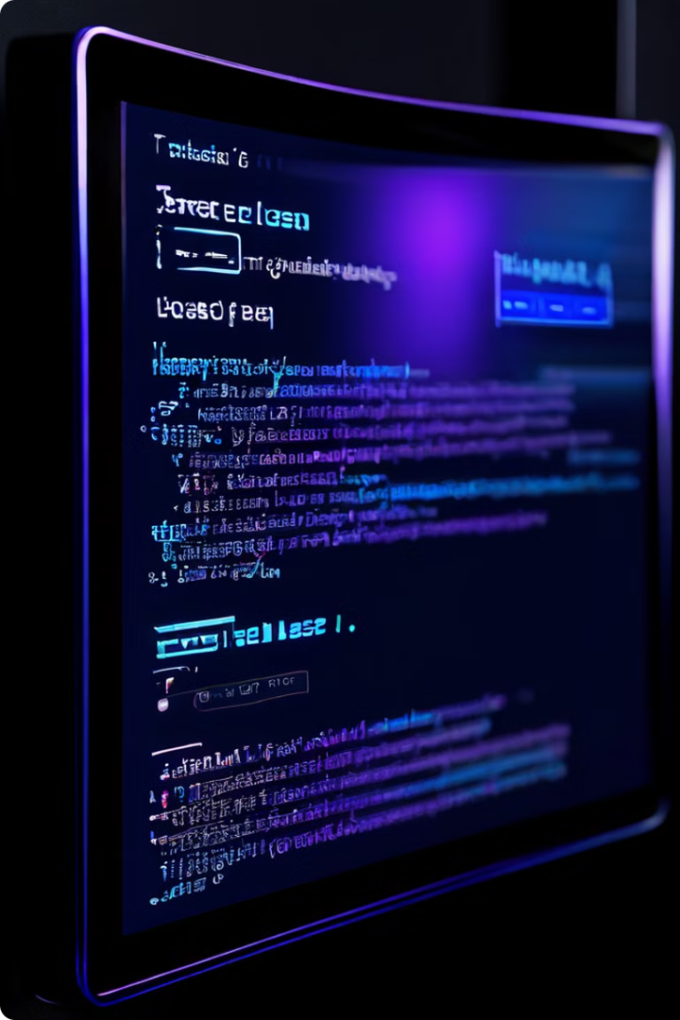
Example Code Snippets
Let's explore some Python code snippets demonstrating key billing software functionalities. This example generates a basic invoice with customer and item details, showcasing Python's power for structured data manipulation.
The code utilizes the `csv` module for file handling and the `datetime` module for timestamps. The invoice data is formatted and written to a CSV file, demonstrating Python's flexibility for data organization and export.
from tkinter import *
import random
class Bill_App:
def _init_(self,root):
self.root = root
self.root.geometry("1300x700+0+0")
self.root.maxsize(width = 1280,height = 700)
self.root.minsize(width = 1280,height = 700)
self.root.title("Billing Software")

Slide 12

Benefits of Using Python for Billing Software
Python offers numerous advantages for building billing software. It's a versatile language known for its readability and ease of use, making it ideal for developers of all skill levels. The extensive Python ecosystem provides a wide range of libraries tailored for billing functionalities, such as invoice generation, payment processing, and reporting.
Python's strong community support ensures ample resources, tutorials, and documentation for developers. This simplifies the development process and provides quick solutions to common challenges. The language's scalability allows for handling large volumes of data and transactions, making it suitable for businesses of all sizes.

Slide 13

Additional Scope Payment Processing
1
Integration with Payment Gateways
Billing software can integrate with a variety of payment gateways such as Stripe, PayPal, and Square. This allows businesses to securely process payments from customers. Payment gateways handle the encryption and transmission of sensitive payment information. This ensures the security and integrity of financial transactions.
2
Multiple Payment Options
Customers have a wide range of payment options to choose from. These options include credit cards, debit cards, ACH transfers, and digital wallets. Supporting a variety of payment methods makes it easier for customers to pay their bills. This can lead to increased customer satisfaction and sales.
3
Automated Payment Reminders
The software can send automated payment reminders to customers via email or text message. This helps ensure that customers pay their bills on time. Automated reminders can reduce the number of late payments and minimize the risk of unpaid invoices.

Slide 14
Conclusion and Future Directions
Python has emerged as a powerful and versatile language for building robust and scalable billing software solutions. Its ease of use,
extensive libraries, and thriving community make it an ideal choice for businesses seeking cost-effective and efficient software development.
As technology continues to evolve, the future of billing software holds exciting possibilities. Expect to see advancements in areas
such as artificial intelligence (AI)-powered automation, blockchain integration for secure and transparent transactions, and personalized
customer experiences. Python's adaptability and its growing ecosystem of AI and blockchain libraries make it well-equipped to navigate
these emerging trends and drive the evolution of billing software.

